Slide 1
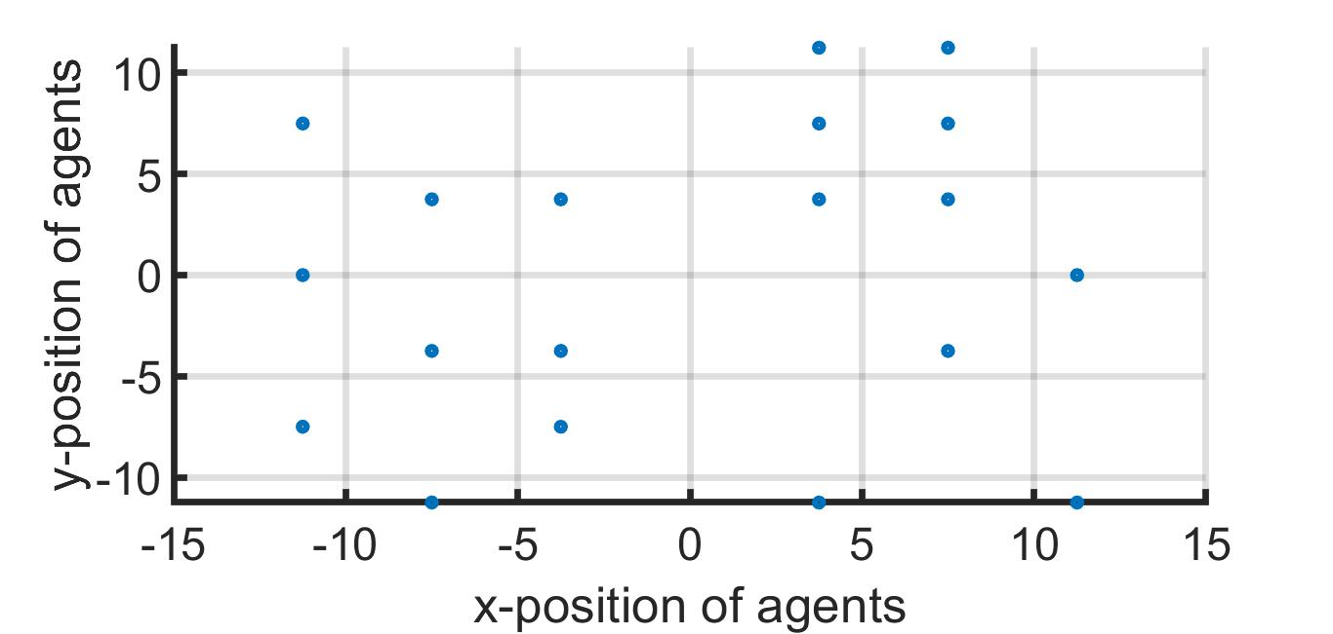
2-D Array

Slide 2
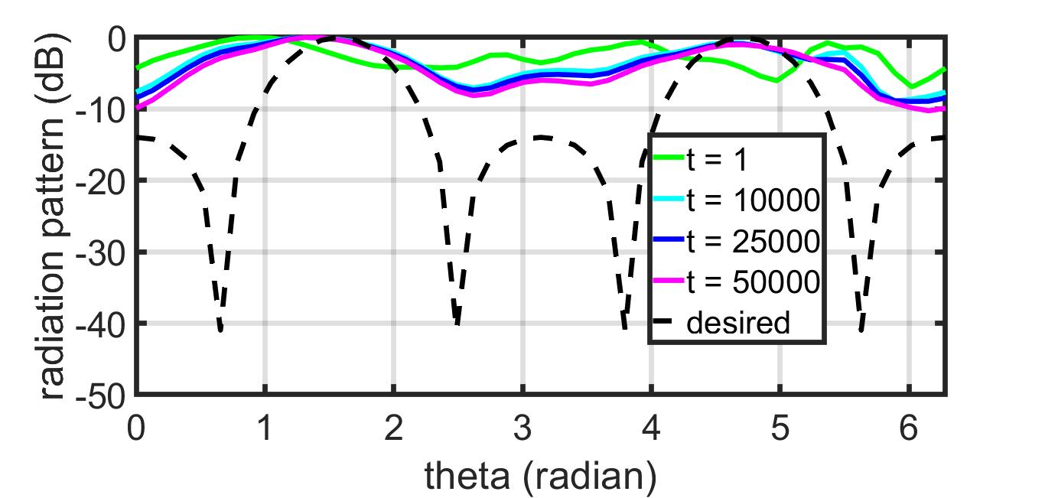
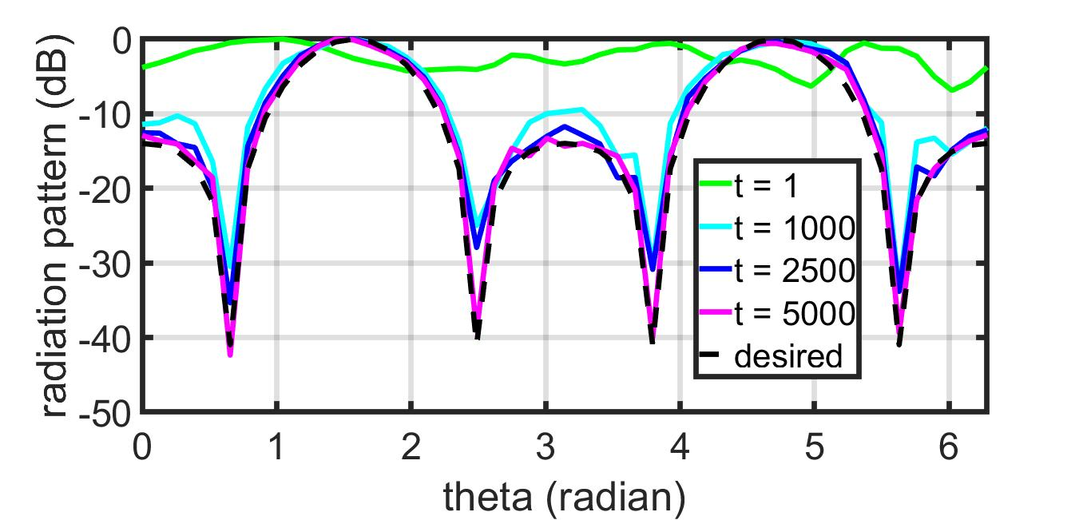
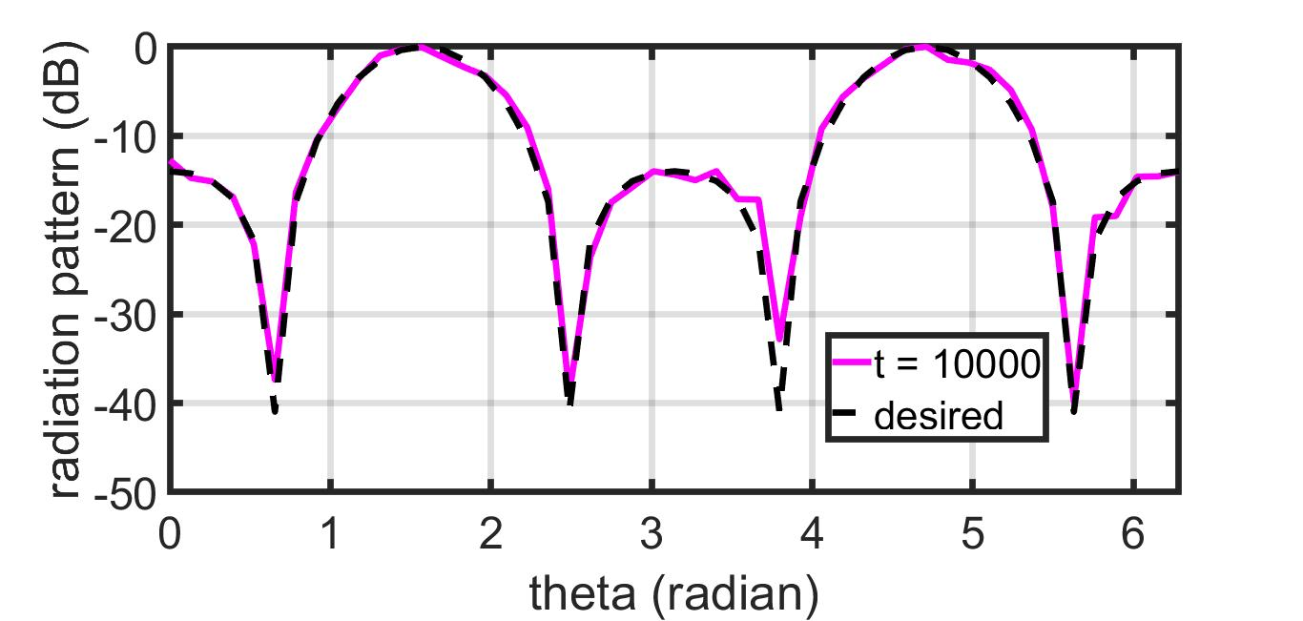
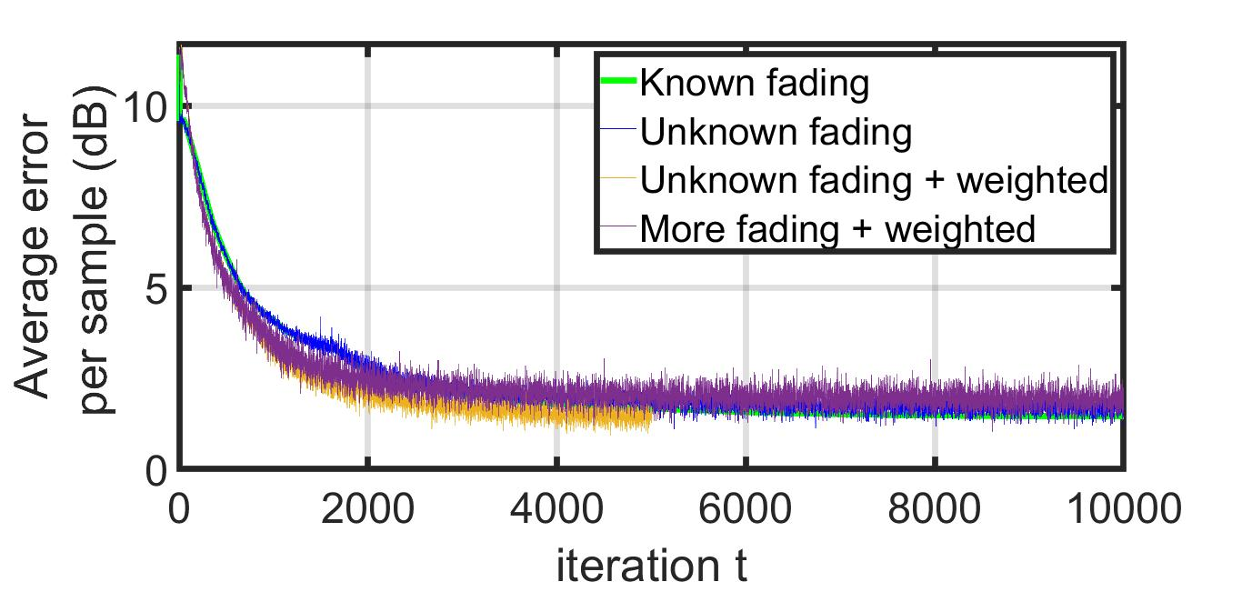
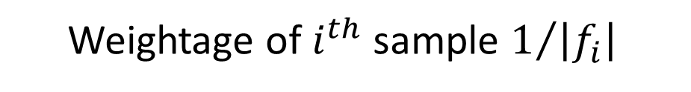
2-D Array – Unknown Rayleigh Fading
GD
IPG
IPG
IPG
Weightage of $i^{th}$ sample $1/{\left|f_{i}\right|}$

Slide 3
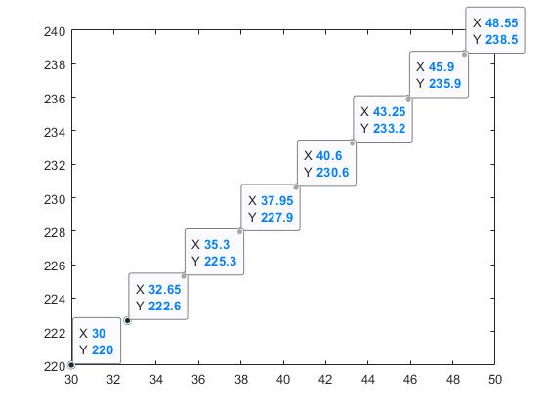
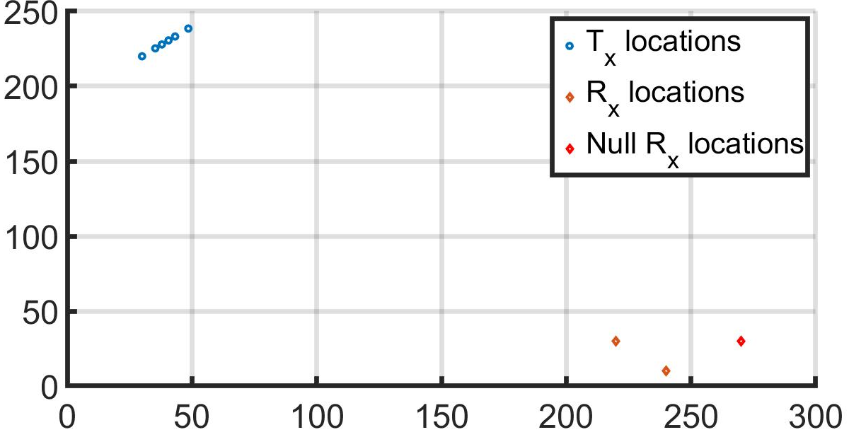
(x,y)-Position of Agents and Receivers

Slide 4
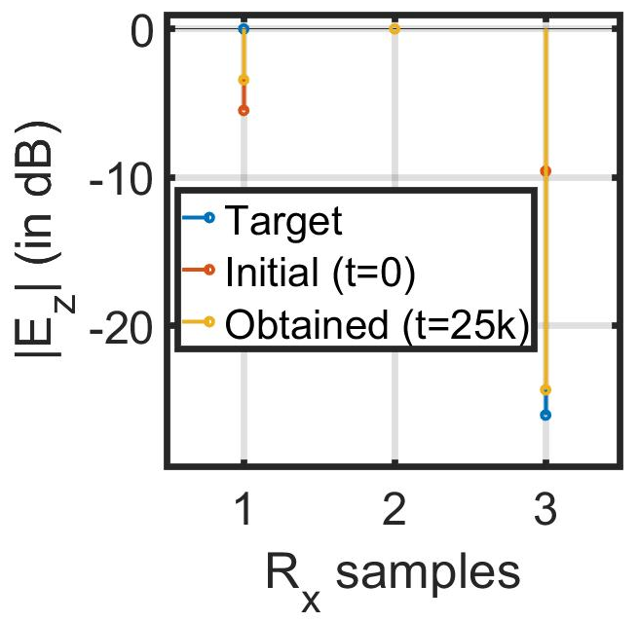
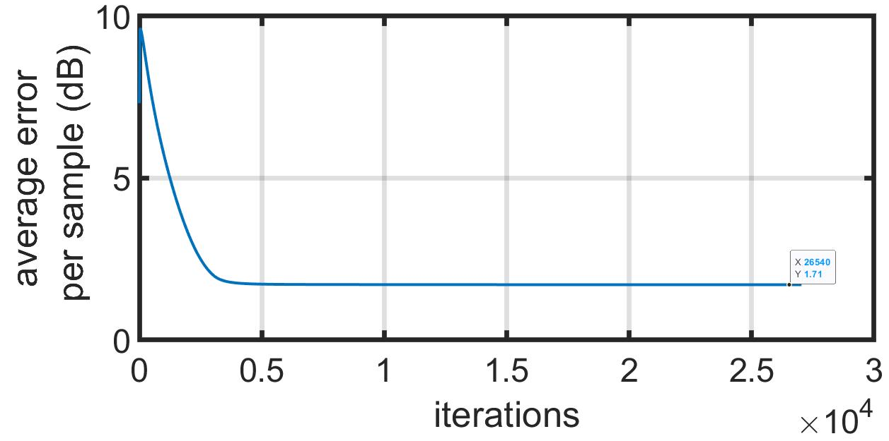
Error Plot of IPG
only |E_z| is considered

Slide 5
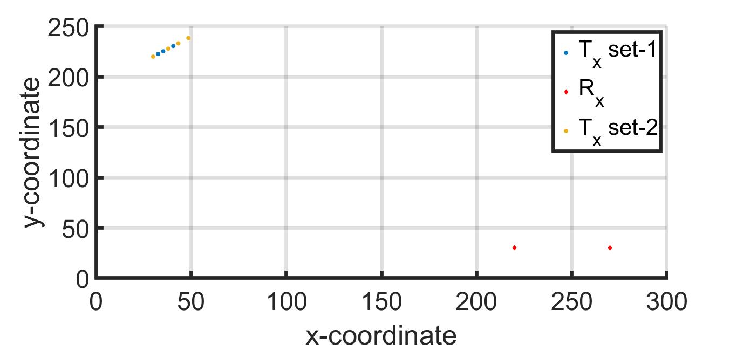
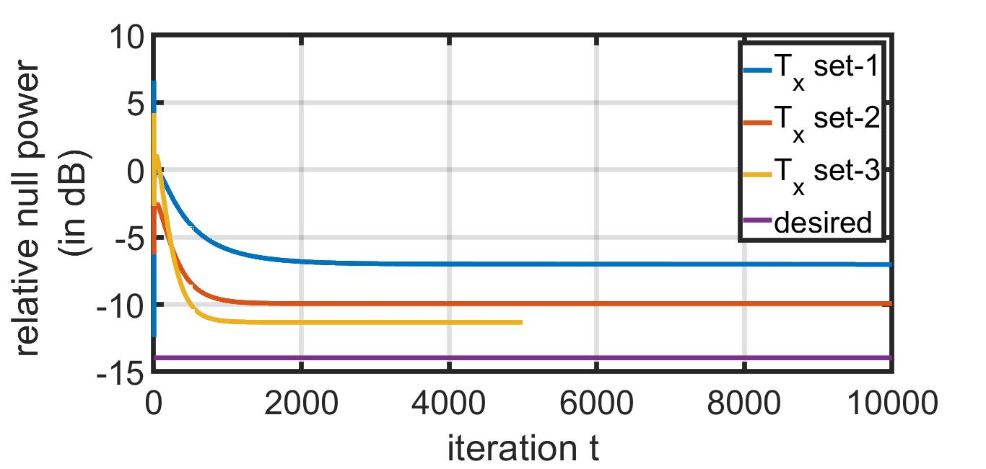
(x,y)-Position of Agents and Receivers

Slide 6
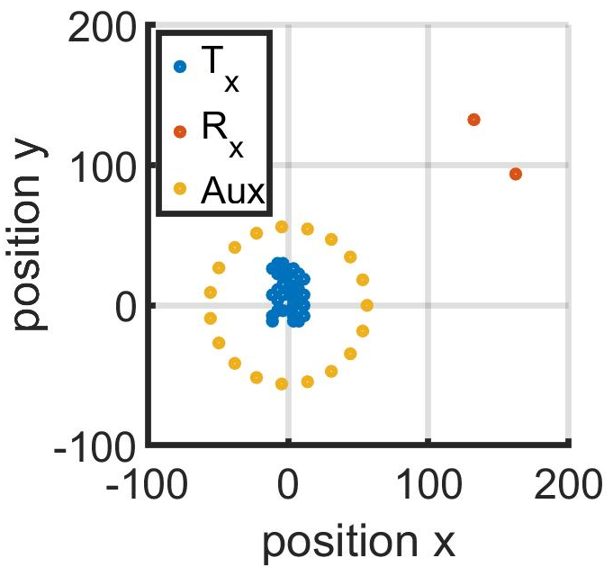
(x,y)-Position of Agents and Receivers
min Tx-Rx distance $\sim 22λ$
# Tx: $32$
# Aux: $10,20$
Rayleigh Fading

Slide 7
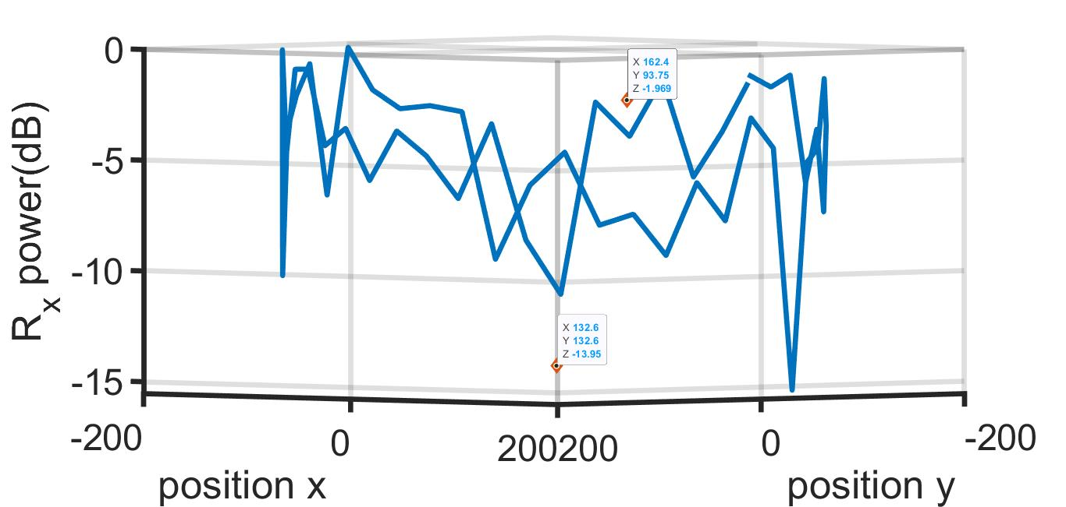
Feedback from $10$ Aux. Nodes
Mean Rx power at $50$ different directions $−4.5 dB$

Slide 8
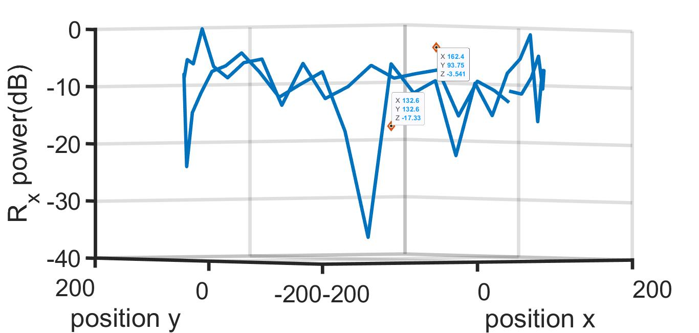
Feedback from $20$ Aux. Nodes
Mean Rx power at $50$ different directions $−9.7 dB$

Slide 9
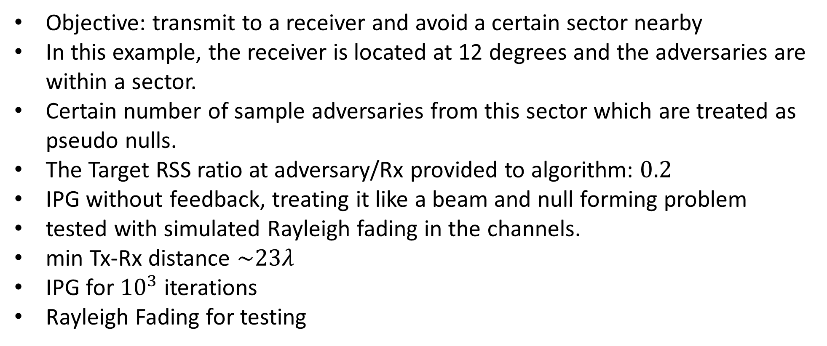
Adversaries in a Sector
Objective: transmit to a receiver and avoid a certain sector nearby
In this example, the receiver is located at 12 degrees and the adversaries are within a sector.
Certain number of sample adversaries from this sector which are treated as pseudo nulls.
The Target RSS ratio at adversary/Rx provided to algorithm: $0.2$
IPG without feedback, treating it like a beam and null forming problem
tested with simulated Rayleigh fading in the channels.
min Tx-Rx distance $\sim 23λ$
IPG for ${10}^{3}$ iterations
Rayleigh Fading for testing

Slide 10
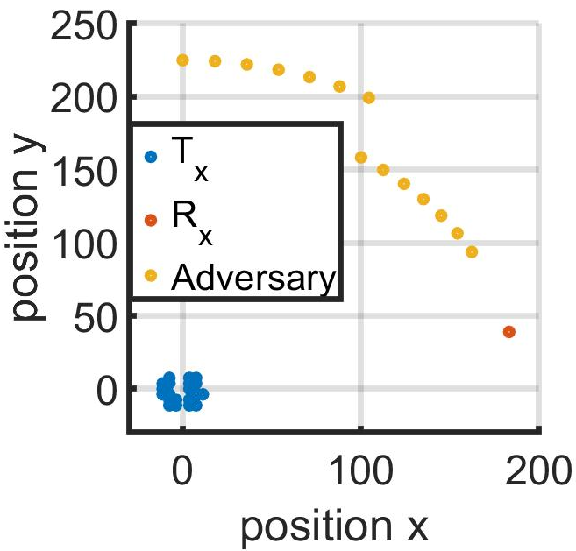
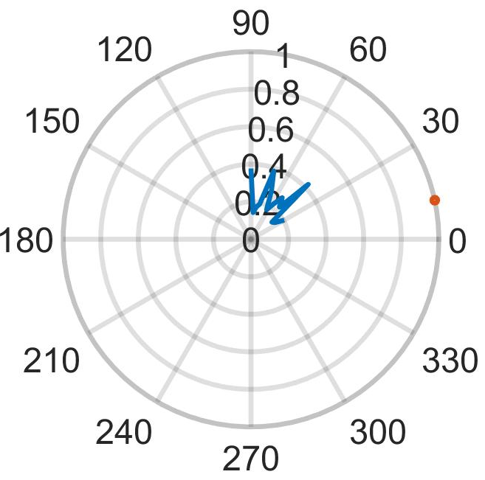

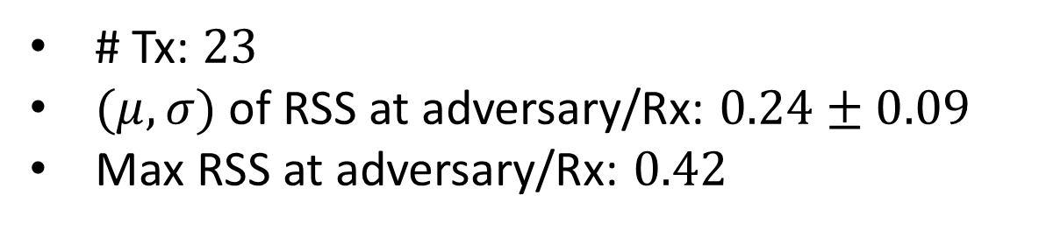
Adversaries: ${30}^{°}−{90}^{°}$
# Tx: $23$
$(μ,σ)$ of RSS at adversary/Rx: $0.24±0.09$
Max RSS at adversary/Rx: $0.42$

Slide 11
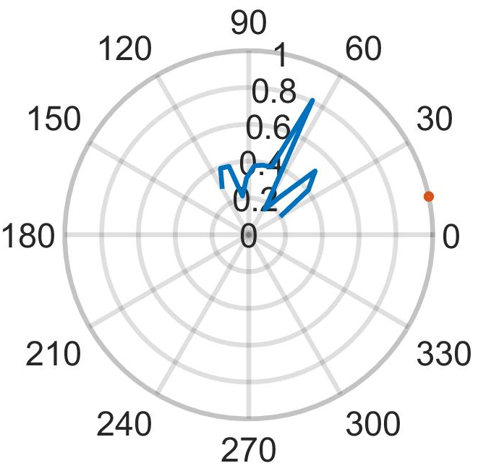
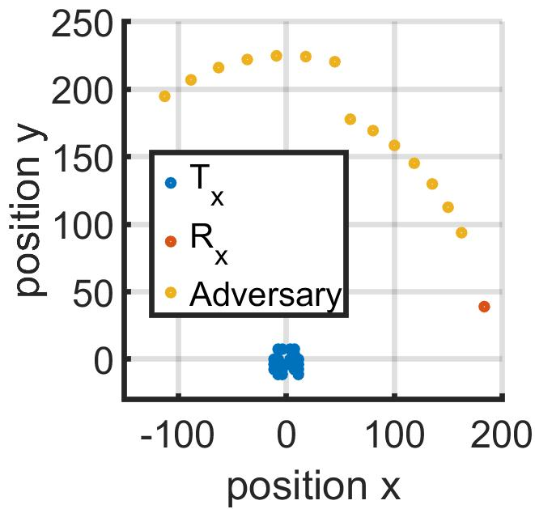
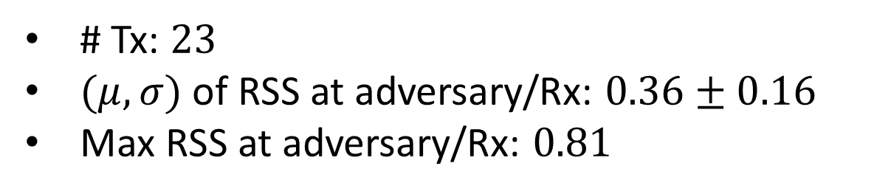

Adversaries: ${30}^{°}−{120}^{°}$
# Tx: $23$
$(μ,σ)$ of RSS at adversary/Rx: $0.36±0.16$
Max RSS at adversary/Rx: $0.81$

Slide 12
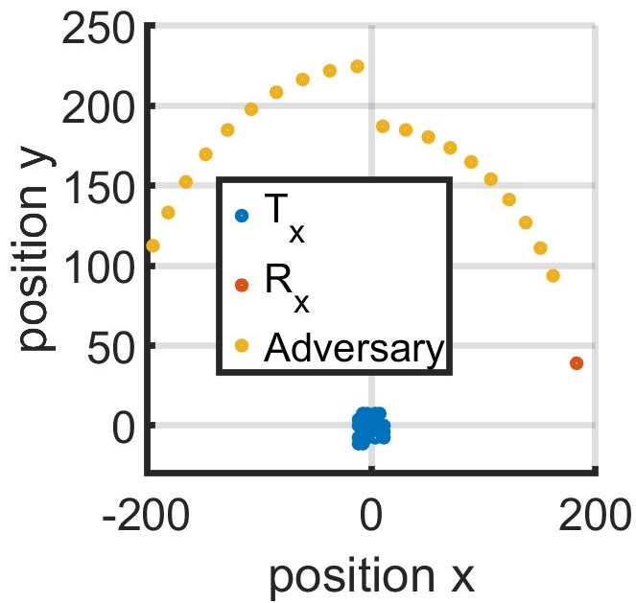
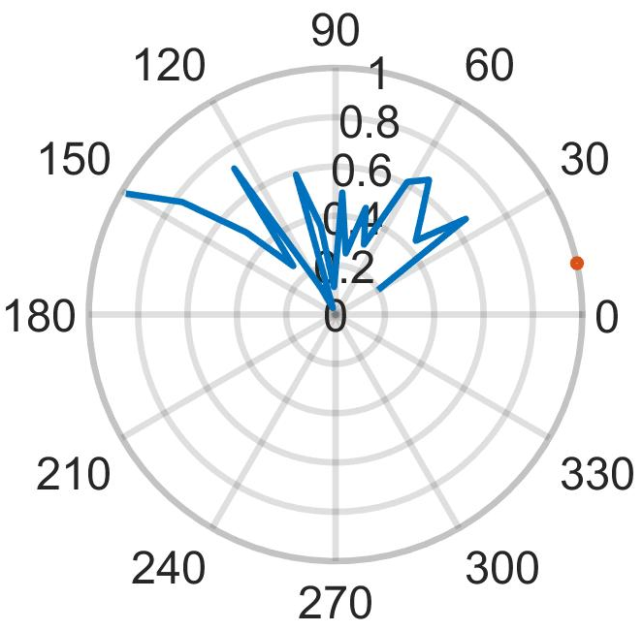
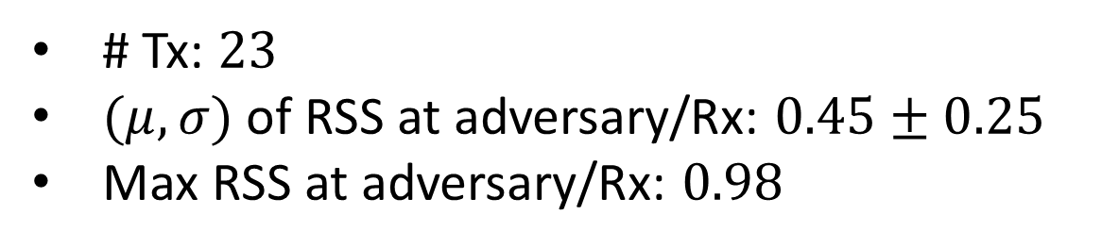

Adversaries: ${30}^{°}−{150}^{°}$
# Tx: $23$
$(μ,σ)$ of RSS at adversary/Rx: $0.45±0.25$
Max RSS at adversary/Rx: $0.98$

Slide 13
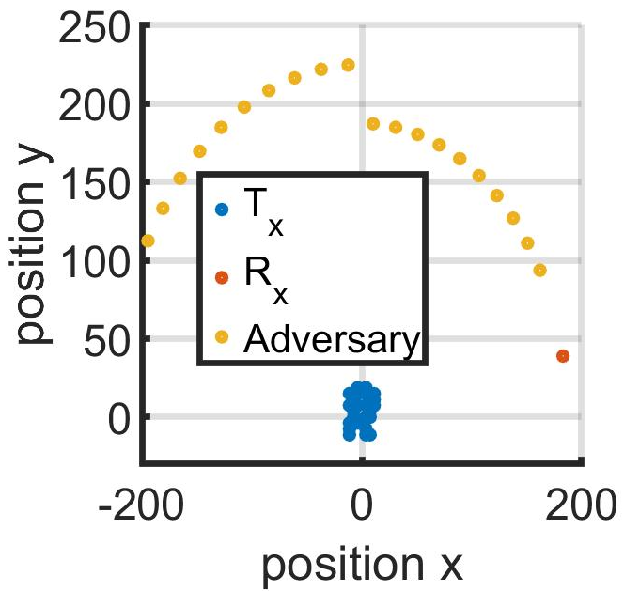
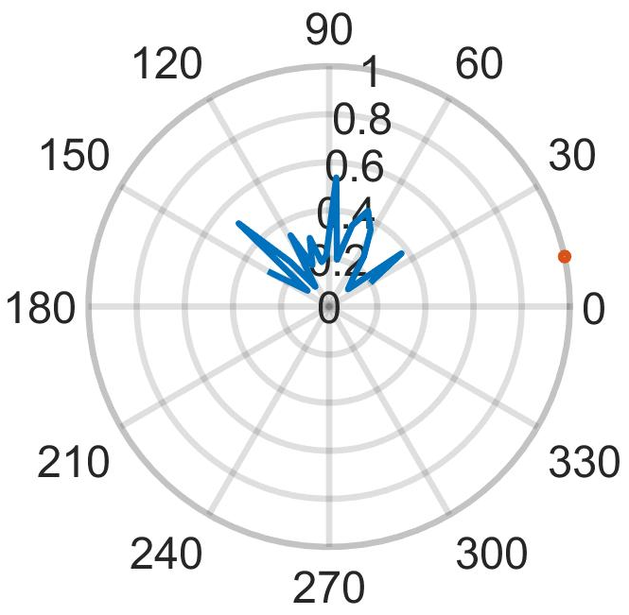
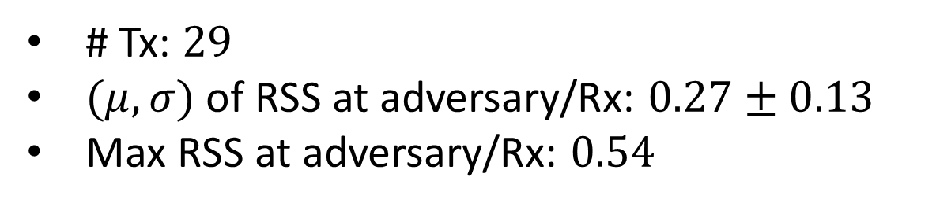
Adversaries: ${30}^{°}−{150}^{°}$
# Tx: $29$
$(μ,σ)$ of RSS at adversary/Rx: $0.27±0.13$
Max RSS at adversary/Rx: $0.54$

